Slide 1
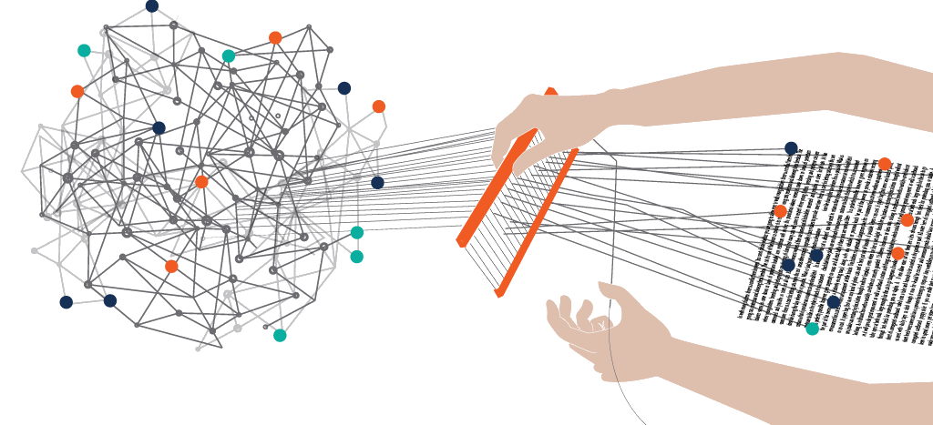
Graduation Project:
Analyze websites’ text content using classification
Mef2103
Student : | Huynh Truong Tu

Slide 2

About me
“I am Huynh Truong TU, currently a senior student at HCM city university of Technology and on-going DIVE INTO CODE course.
With the guidance from the instructors, I managed to finish all the sprint assignments and now this is my graduation project. Thank you very much!”
The overall of this assignment is that it is a NLP-related project where the models will process the text content from a website then predict which industry the website belongs to.
I use pure statistics of the “key words” of each industry field so that the models can “weight” the class of an sample base on the number of “key words” it holds.
The output of this project can be used as input for other fields such as marketing or data analytics.

Slide 3
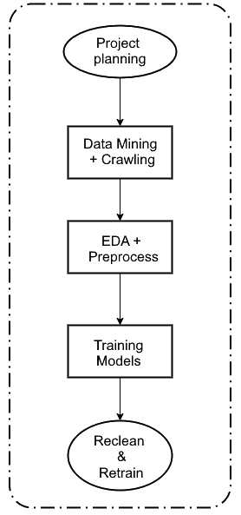
Project Planning
Goal: Classify website in predefined list of industry
Input: Text of a webpage -> Output: Industry Field
Data mining & Crawling
Find dataset that have domain & it’s text & labeling
Use crawling tools to fill the missing features
EDA + Preprocess
EDA: use statistic to collect insights of the data corpus
Using NLP tools to preprocess data from EDA result (remove html tags, stop words, symbol, lemma, …)
Training models
Use TF-IDF to find & weight the “keywords” and use them for classification.
Reclean & Retrain
Base on the results, make adjustments and retrain.
Overview

Slide 4
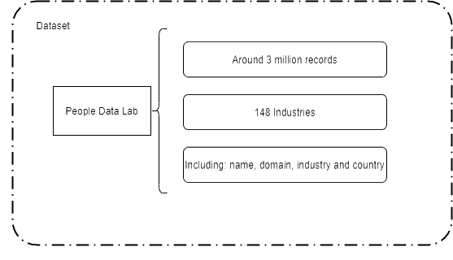

Dataset
Bought from People Data Lab (a Data company) which includes millions of records
It doesn’t contain text of the domain so crawling text data from domain is required using tools.

Slide 5
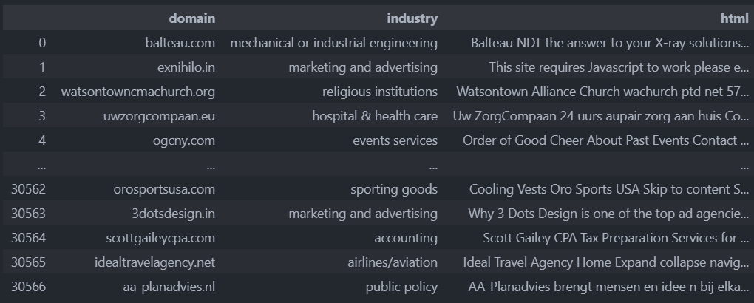
Dataset

Slide 6
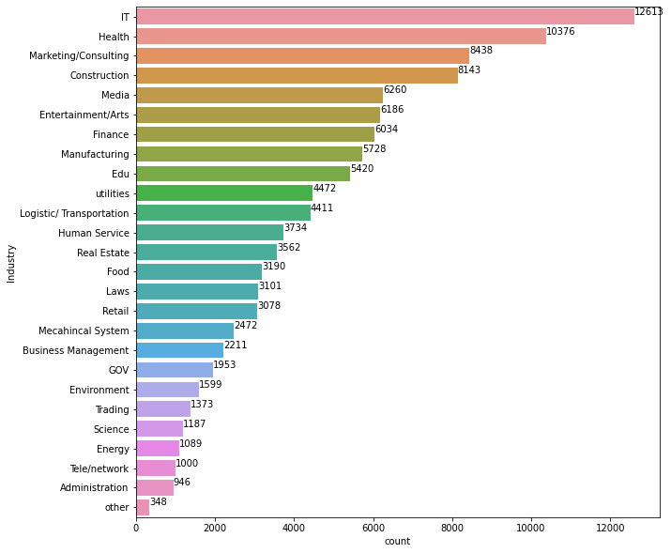
Dataset
26 main industry
148 sub industry
For this mini-project → Predict main industry

Slide 7
Input
Preprocess
Raw data
List_sen =
Input split(['SPACE'])
Cleaning
Tokenizer
Stats Uni/bi gram
Remove short sentence
Lemma
sort list_sen by length
Fit simple ML
remove trivia words
remove stopwords & website stopwords
TRAIN

Slide 8
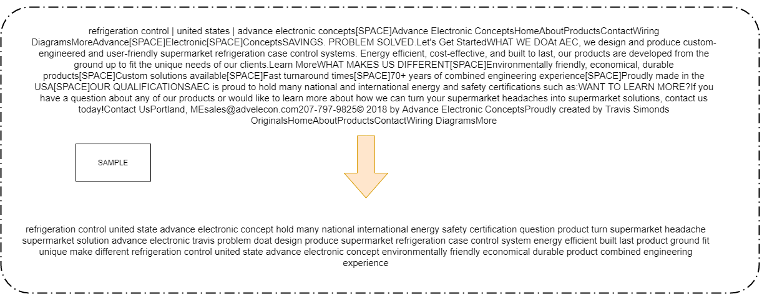
Preprocess

Slide 9
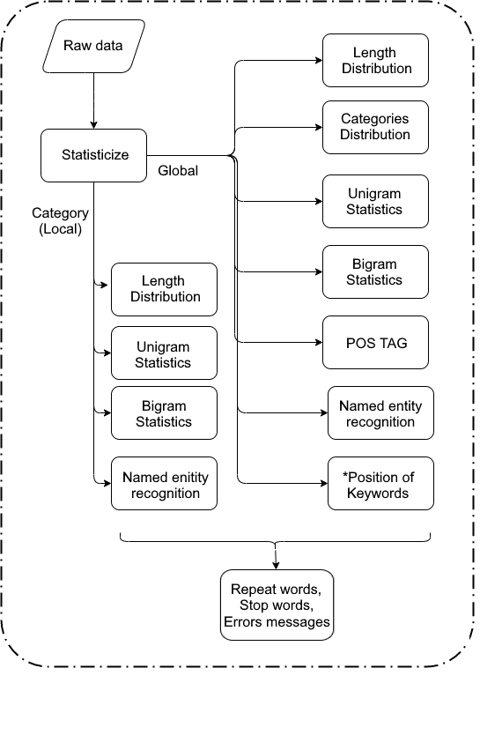
EDA

Slide 10
N-gram Language Model
An N-gram is a sequence of N tokens (or words).
“I learn data mining.”
A 1-gram (or unigram) is a one-word sequence: “I”, “learn”, “data”, “mining”.
A 2-gram (or bigram) is a two-word sequence of words: “I learn”, “learn data”, “data mining”. -> bigger size regarding bags of words
In this mini project concept ( predict using occurrence of keywords - TfIDF) → mainly using unigram

Slide 11
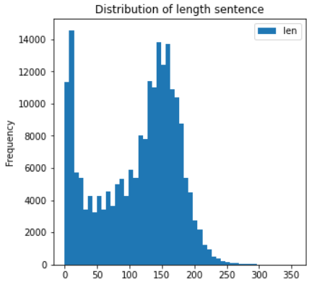
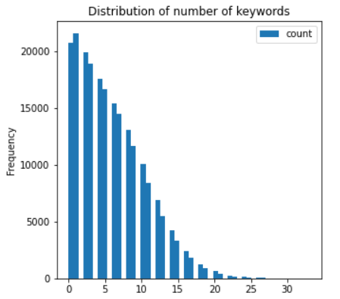
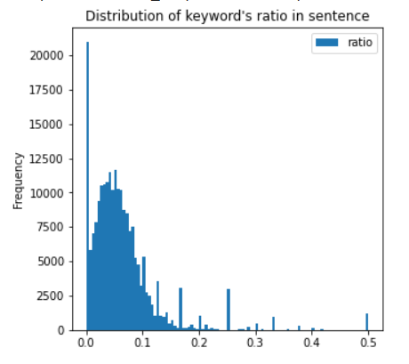
EDA

Slide 12
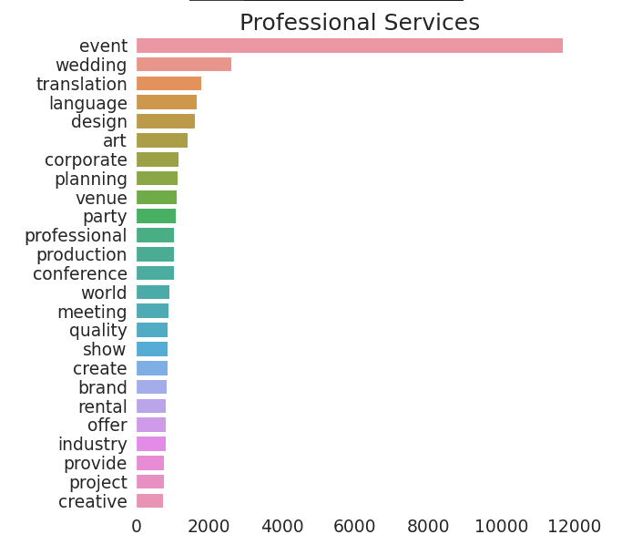
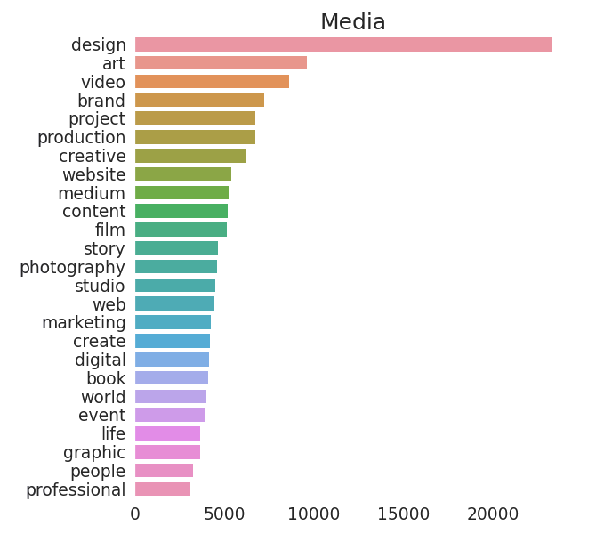
EDA

Slide 13
Validation Results
Uni TF-IDF
Linear Support Vector (loss : 'squared_hinge')
Acc = 0.6666666666666666
Stochastic Gradient Descent (loss function: 'squared_hinge')
Acc = 0.7569504310344828
Logistic regression (loss: ‘Log Loss’)
Train Acc = 0.841
Validate Acc = 0.734
Voting Classifier (LR, SGDC)
Acc = 0.7863673660766616
Bi TF-IDF
SGD Classifier (loss function: 'squared_hinge')
Acc = 0.679138500235812

Slide 14
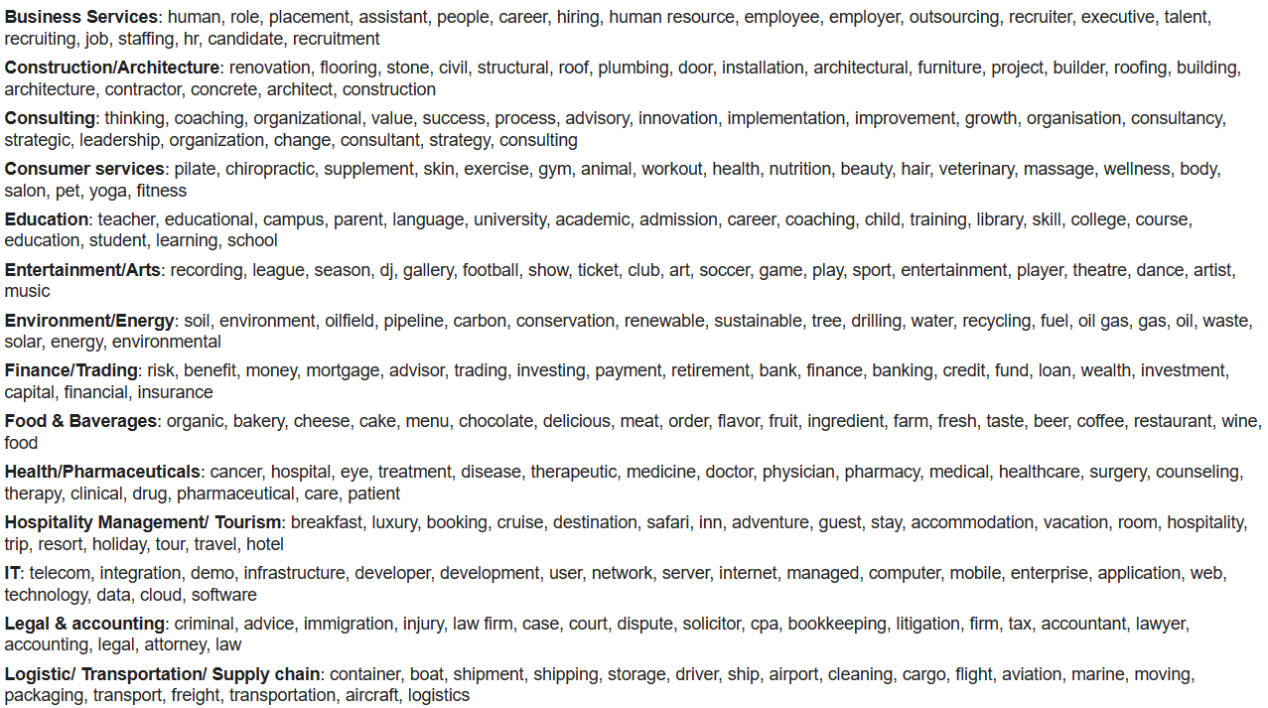
Extract Top Keywords
. .
.

Slide 15
Limitations & Future developments
Limitations:
TF-IDF: purely statistics - occurrences of keywords.
→ Newspaper domain: low accuracy
→ Can’t make use of pos tag & named entities (after stemming & lemmatization the structure is lost)
→ Some industries with relative fields may be confused
The scope is limited in English domains.
Output depends on the categories of industries (Each country has different way of industrial classification.)
Future development:
Combine with CVision.
Replace TF-IDF with BERT from Google (pre-train model, highly accurate, applicable for many languages including Vietnamese)

Slide 16


